Slide 1
CTEC Project Mushcheck

Slide 2

Problem Statement
Campers and enthusiasts spend a lot of time and effort in identifying mushroom species and determining if they are edible or not.

Slide 3

Features
Dictionary of mushrooms will be retrieved from a database so that the information can be easily updated on-the-fly.
A unique user ID will automatically be generated based on the machine’s hardware and software information and stored as a cookie.
The ID will be used to link the user’s past scans to the user so that they may access their past scans.
The links to past scans is only visible to their owner, but anyone with the link may view the scan, allowing easy sharing of scans between devices and people.
Scans will be deleted if no one visited the links in the last 30 days

Slide 4

Amplify
Deployment of static web app
Continuous integration and deployment

Slide 5

RDS
Optimised for structured data
Low downtime

Slide 6

AWS Lambda
Serverless, scalable functions
Leads to modular code
Charged by usage

Slide 7

API Gateway
Simple management
Secure
Scalable

Slide 8

S3
Low-latency
More suited for storing images than RDS

Slide 9

Rekognition
Able to train model for custom labels
Good performance and accuracy

Slide 10
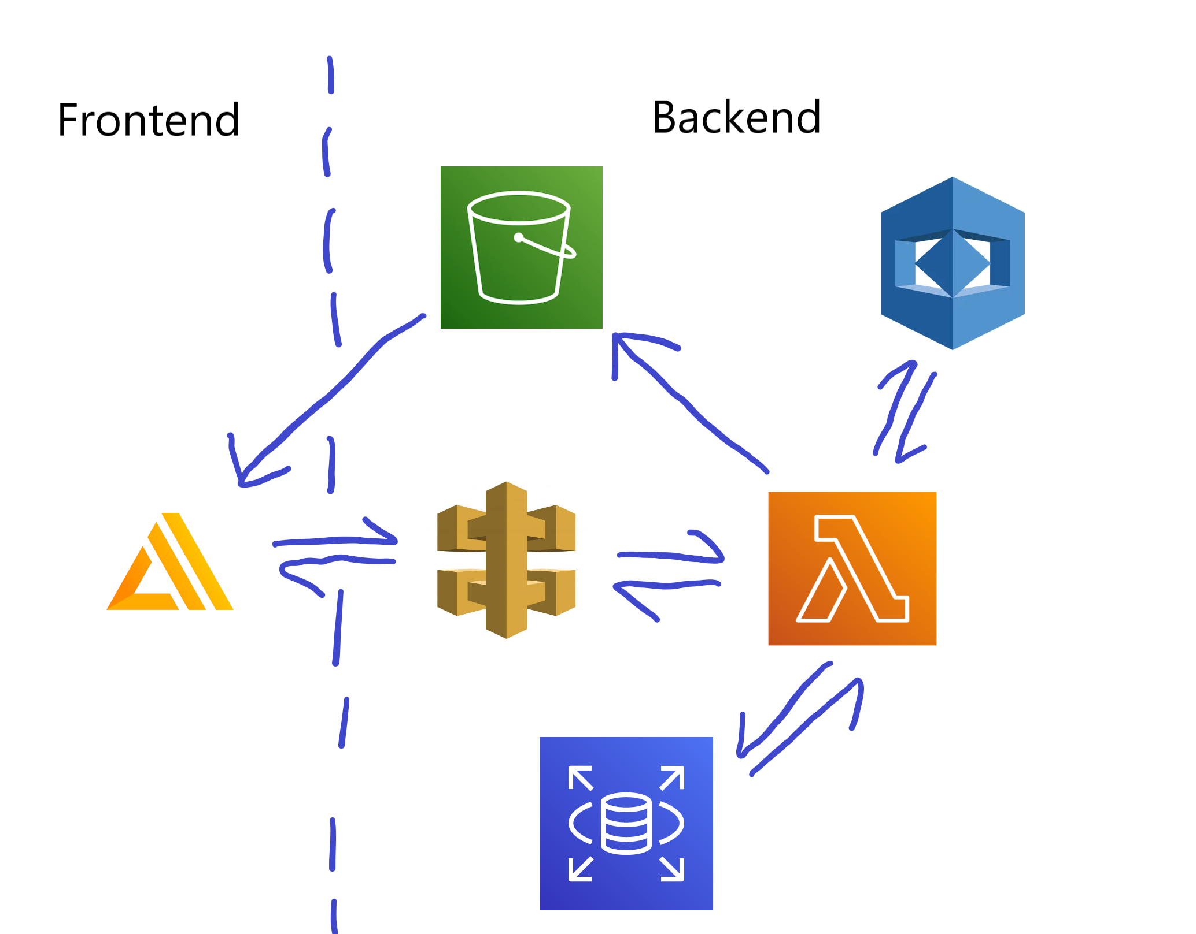
Overview of services used

